Slide 1





Therapeutic Thinking for Parents
Creating a culture of behaviour that lasts

Slide 2


Aims for the meeting
What is Therapeutic Thinking
Inclusion
What we do in school
Consequences

Slide 3
“You can’t make a child feel better by making them feel worse”

Slide 4

What is Therapeutic Thinking?
Therapeutic Thinking is a whole school, cultural approach that focuses on improving educational outcomes for ALL.
Children are supported and encouraged to build relationships with adults and peers
Individual needs (behaviour and inclusion) are being met.

Slide 5
What is Therapeutic Thinking?
Staff modelling encourages children to be kind, tolerant and accepting of others.
Lowers the risk of more dangerous behaviours.

Slide 6
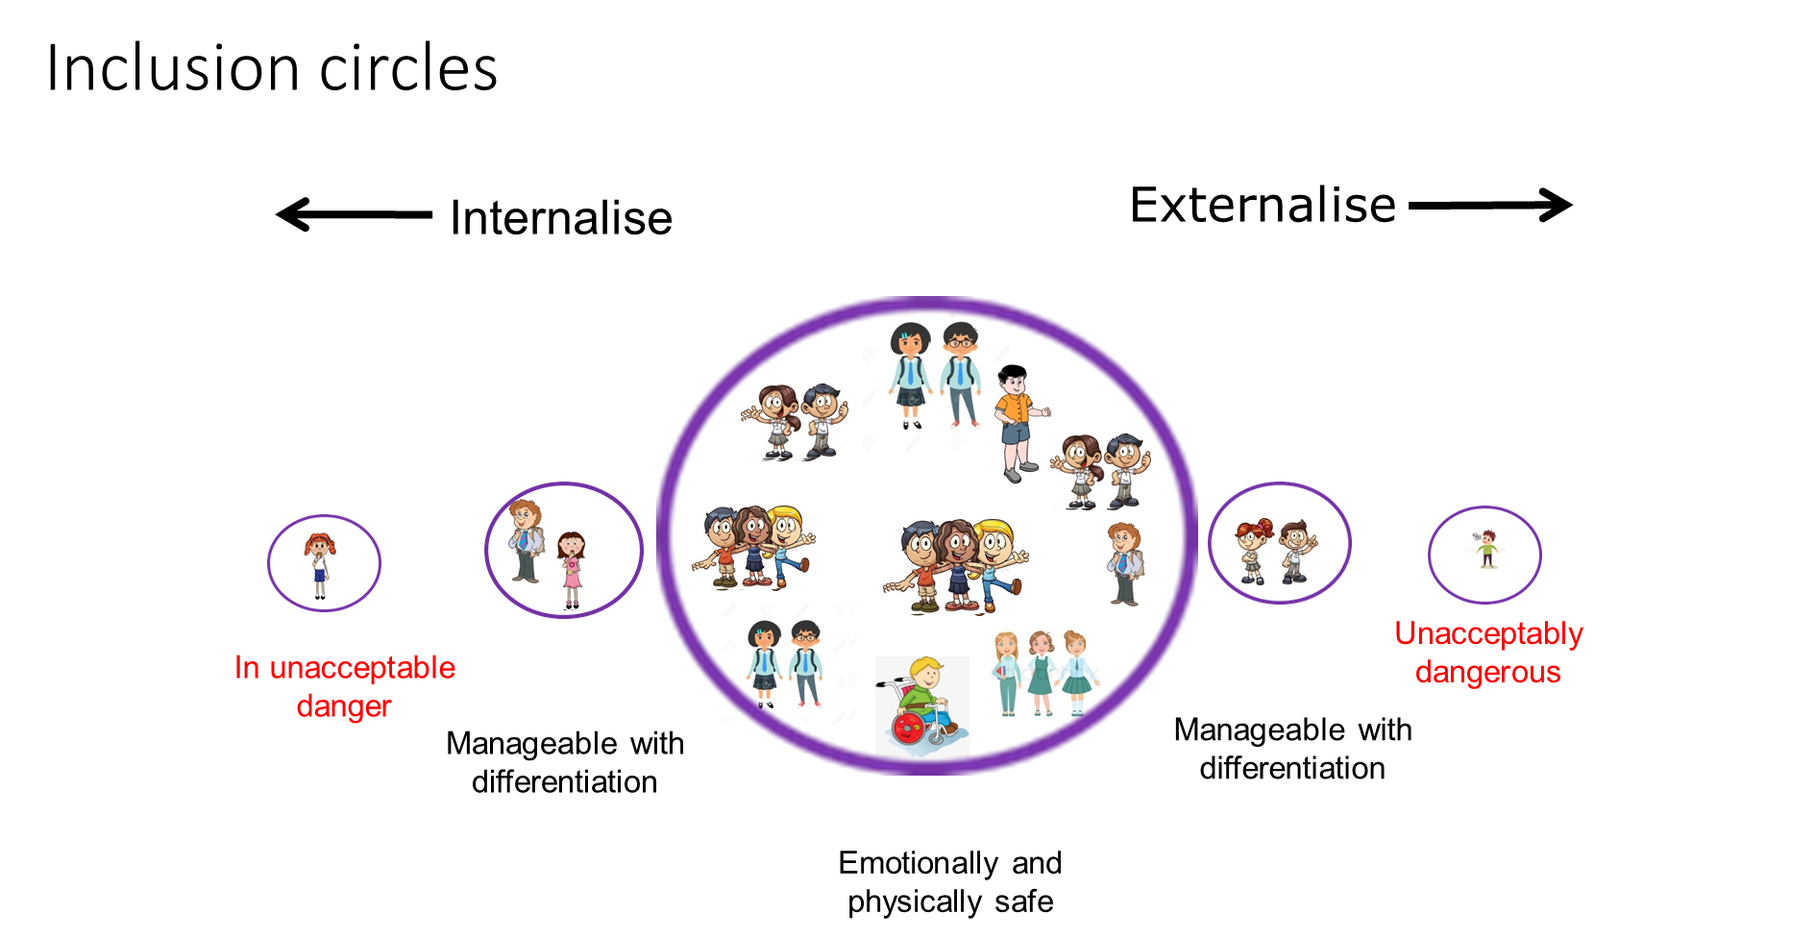
Inclusion at Parrett and Axe

Slide 7
How we do this...
We have rewritten the school behaviour policy (which can be viewed on the school website)
Using a graduated response for behaviour:
Universal Provision
Targeted
Specialist

Slide 8
The language of Behaviour
We know there is a reason for ALL behaviour.
As a school, we no longer use terms such as good, bad or naughty.
We talk to the younger children about making the right or not right choices.
In KS2 we talk about behaviour that is expected and unexpected. This removes the negativity.

Slide 9

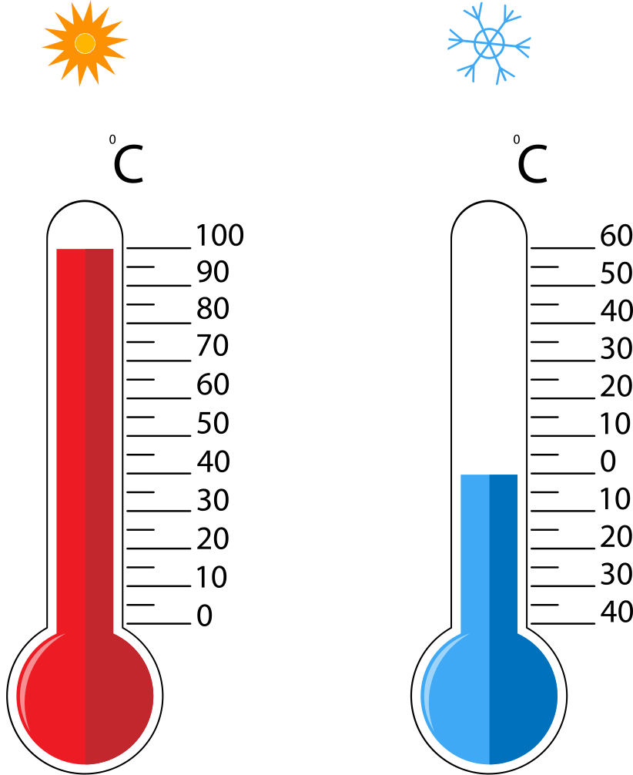


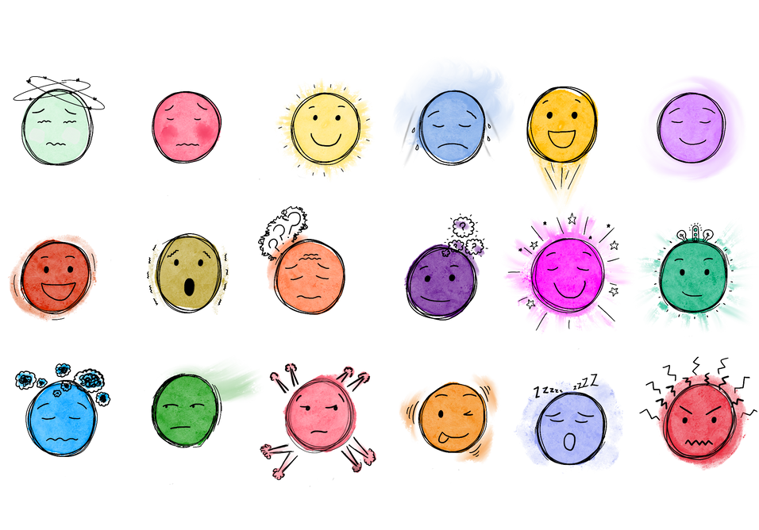









The root of the problem
When children are dysregulated, they can find it difficult to communicate their feelings.
So we start by using visuals to help us understand.
We also use positive language
Something is wrong…
Hungry
Cold
Hot
Toilet
Dirty
Tired
Sick
Scared
Something at home
An argument
Friends
Change
Worried
I miss someone
Confused
My work
A teacher
Bored
Sad
Family

Slide 10
The root of the problem
When dealing with incidents both in and out of the classroom we make sure that all voices are heard and we encourage the children, where possible and with support, to come up with ways to diffuse the situations themselves.
Nobody is dismissed, nobody is ignored.
Everything is followed up.

Slide 11
Consequences
There are 2 different types of consequence.
Protective consequences are necessary measures to manage the risk of harm. Protective consequences may limit freedoms.
Educational consequences progress the child’s understanding and engagement. Where protective consequences are necessary educational consequences should allow the gradual removal of adaptations. Educational consequences return freedoms.

Slide 12
Consequences
And...
Educational consequences progress the child’s understanding and engagement. These should allow the gradual removal of adaptations.
Educational consequences return freedoms.

Slide 13
Consequences
These consequences are always discussed with the children but this may not be done straight away. A child needs to be regulated in order to understand a consequence.

Slide 14
Minor Adjustments
Some children may need smaller adjustments made both in and out of the classroom to help them feel included:
Set seating
Time in the calm space
Extra support and resources

Slide 15
Therapeutic Plan
These are used as part of our targeted provision for children that may need a little extra support.
If a class teacher decides one of these is appropriate for your child then a meeting will be set up with yourselves and some targets discussed.

Slide 16

Any questions

Slide 17


